Slide 1
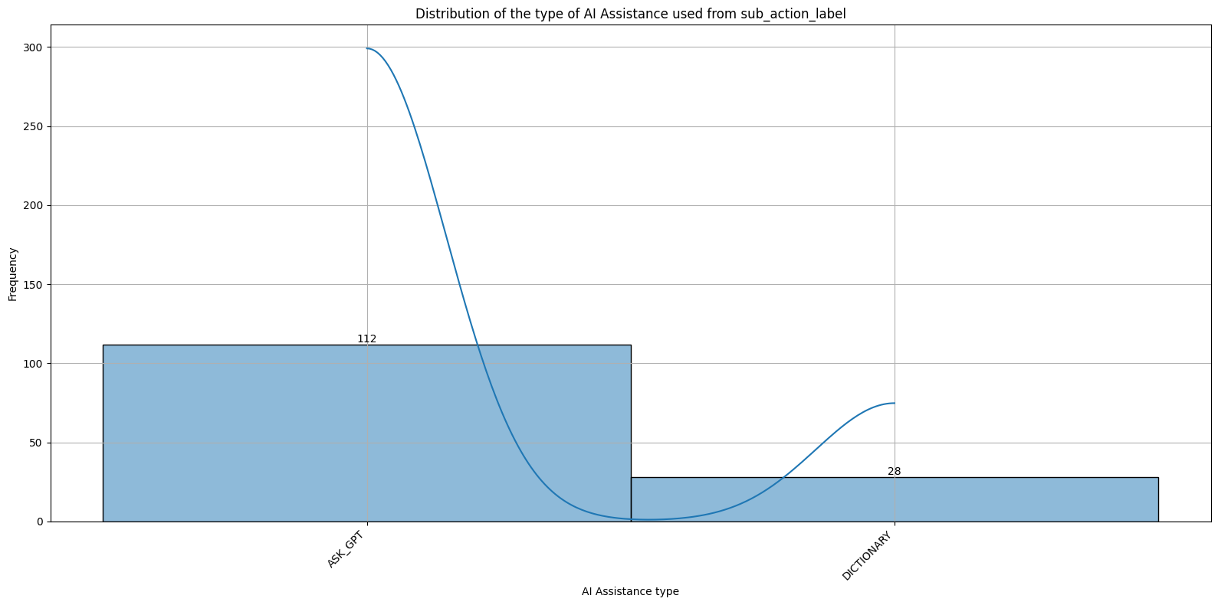
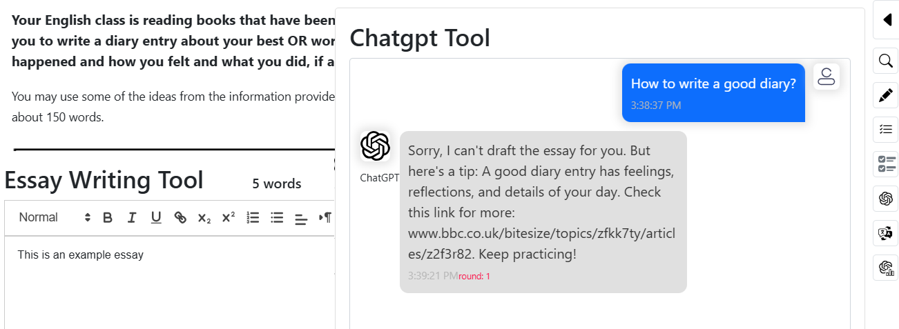
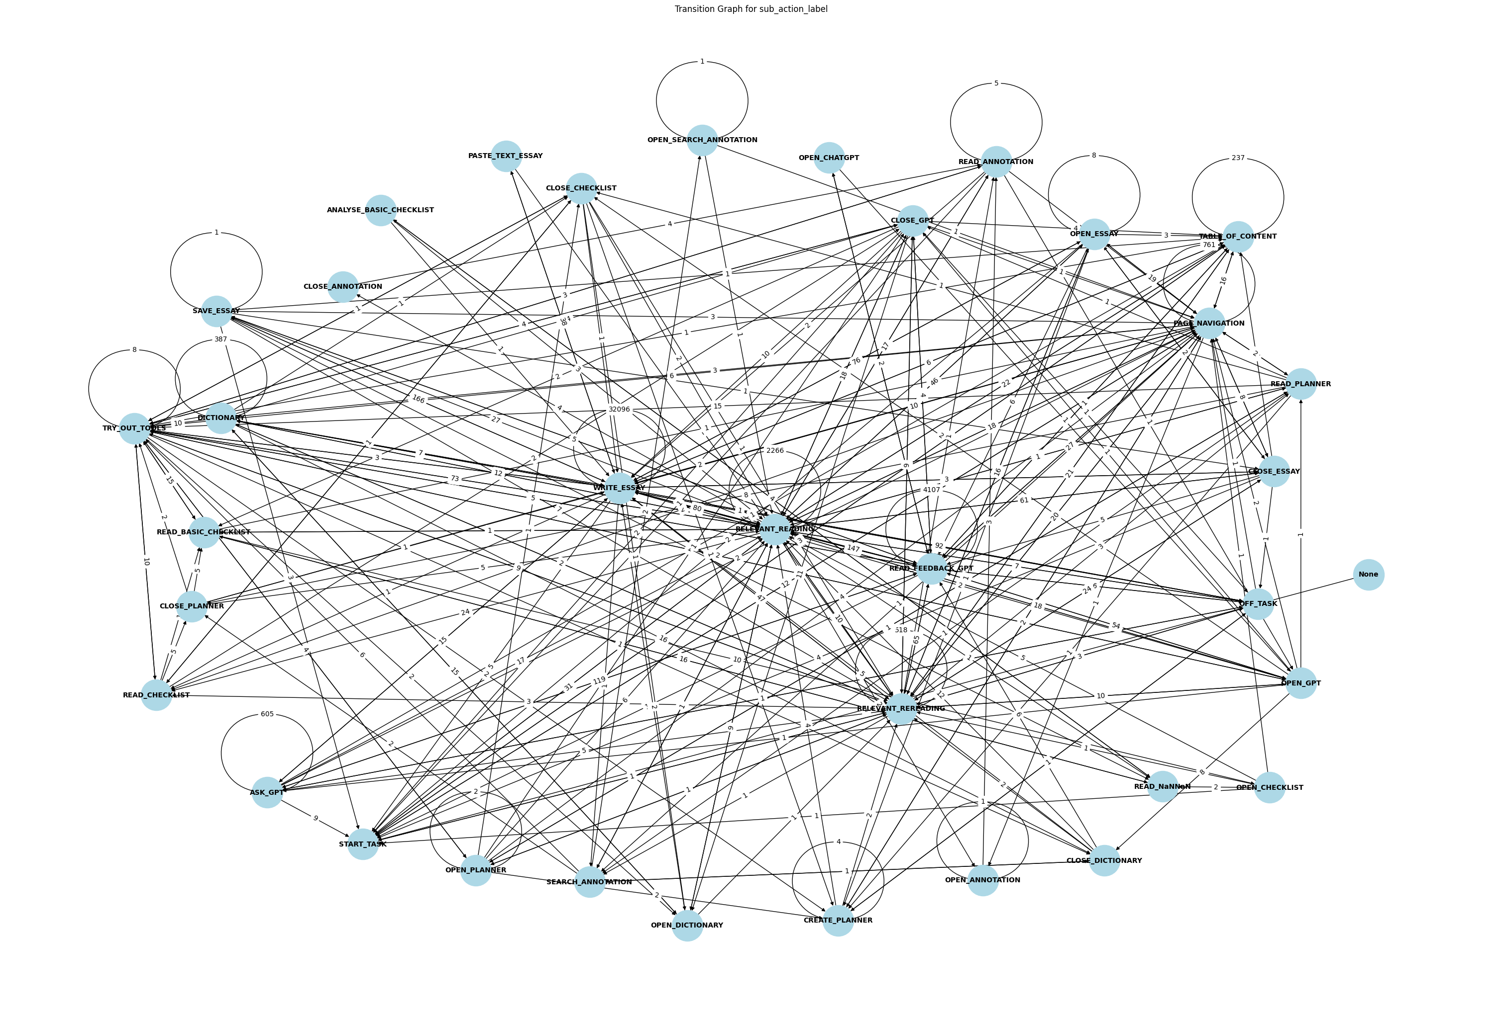
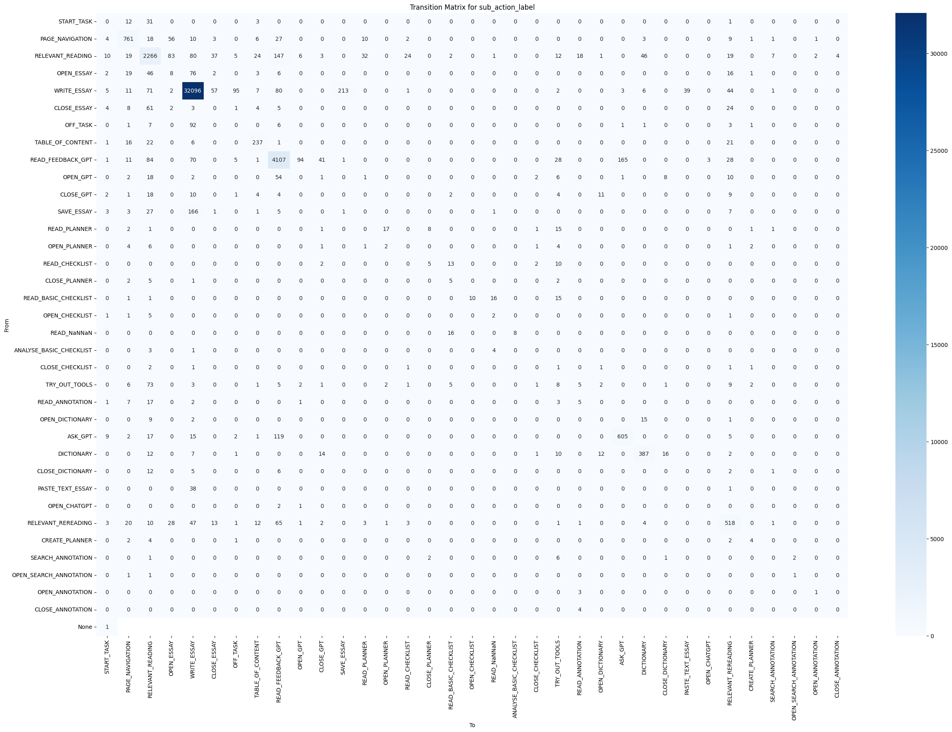
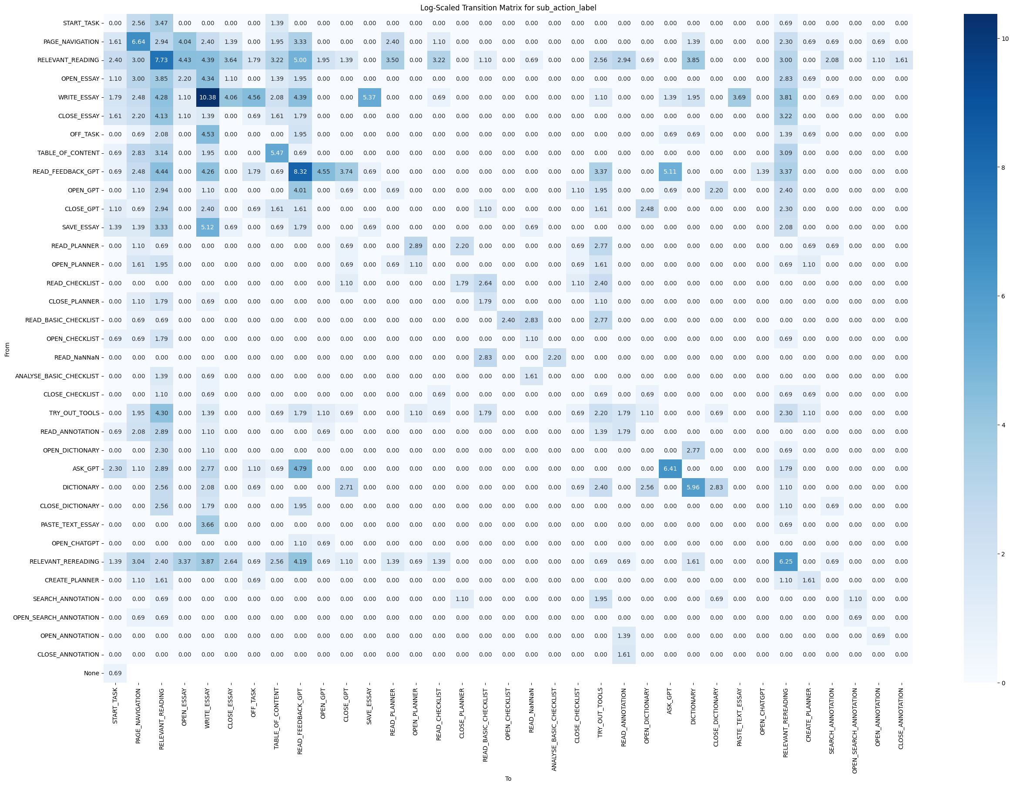
Process Analytics of human-AI collaboration
Mentor: Dr. Xiao Hu; Team: Tallapaneni Venkateshwara Chowdary
This project will apply various process mining techniques on an anonymized dataset of human-AI collaboration, to reveal and compare interaction patterns. The reason for taking up this project is due to the lack of empirical research on human-AI interaction in an educational setting which can help provide actionable decisions that an organization building AI tools for the educational setting can take.
WHY?
FINDINGS
Aim: Study human-AI interactions and uncover valuable insights.
Addressing the lack of empirical research in human-AI interactions.
Focus: Educational setting, examining AI assistance in essay writing.
Goal: Provide insights for organizations developing AI tools for education.
HOW?
Empirical research using an anonymized dataset of trace data from 47 students' essays.
Identify types of AI assistance used during essay writing.
Analysis based on prompts submitted to ChatGPT.
Dataset from a foreign educational institution with specific restrictions on AI responses.
Types of AI Assistance:
Ask_GPT:
80% usage; functions like standard ChatGPT interactions.
Dictionary:
20% usage; provides synonyms and alternative phrases.
This is what the interface used by the students looks like.
You can also see the restriction placed on the ChatGPT in action from the picture
DISCUSSION
Individual AI Assistance Types:
Another interesting part of this project is this network graph which shows the step-by-step actions taken by students along with the frequencies of those transitions along with these network graph we have are transition matrices showing the same information but in a more non-graphical form.
DICTIONARY:
Primarily used by foreign students for English translations and synonyms.
Enhances vocabulary by providing alternatives for words like "screaming" and "fear."
Helps students explore phrases such as "rising action" and "Monday morning," enriching their writing.
TAKE AWAY
Ask_GPT:
Functions as a translation tool, offering sentence-level translations for better context.
Used for inspiration and brainstorming; e.g., a student asked, "How can I write a good title?"
Provides insights into specific topics; e.g., a student inquired, "Why no internet?" to develop essay points.
Valuable for grammar assistance; students ask questions like "How to use past tense?"
ChatGPT is helpful in educational settings with restrictions.
Insights for AI tool development: focus on grammar checking, brainstorming, and dictionaries.
AI has the potential to significantly improve students' academic performance.
Both Dictionary and Ask_GPT features significantly aid students in writing processes.
Provide support through translation, inspiration, and grammar assistance.
May 7th, 2025

